Slide 1
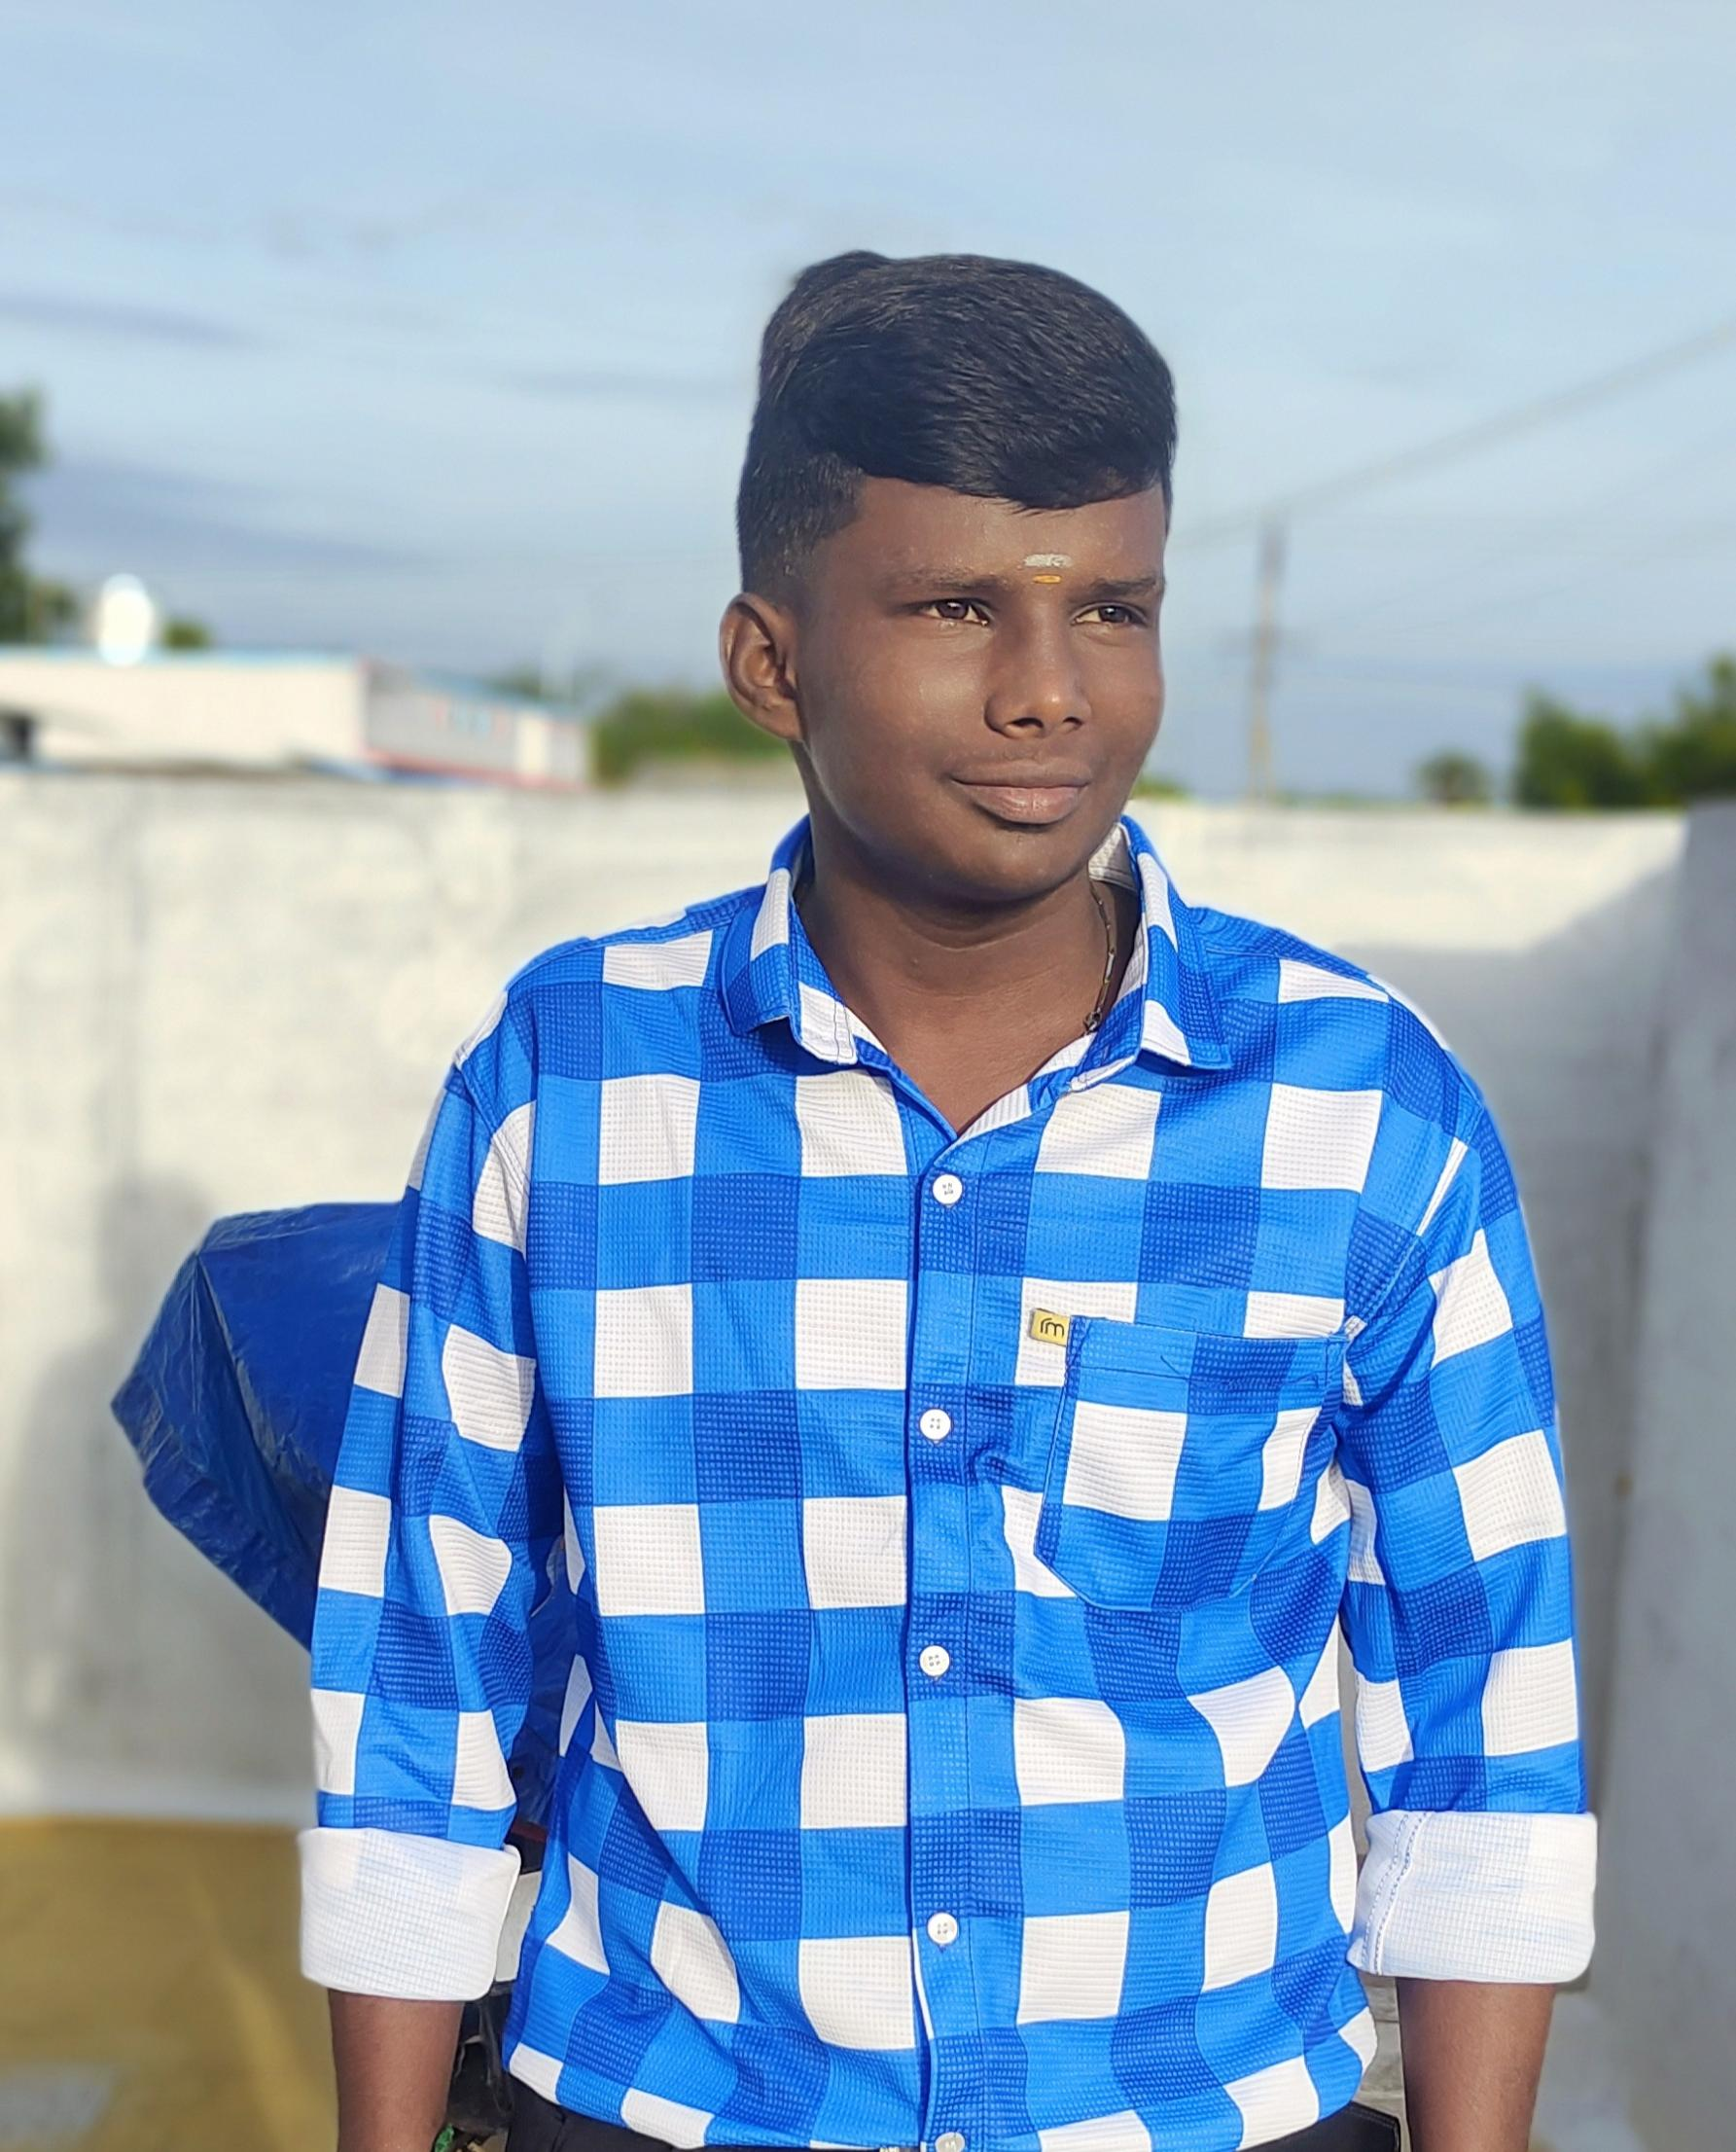
DIGITAL PORTFOLIO OF HARI KRISHNAN .S
Name :HARI KRISHNAN .S
Register no and NM : 2422J1108 AND ASBRU062422J1108
Department : BACHELER OF COMPUTER APPLICATIONS
University : BHARATHIYAR
College : CHIKKANNA GOVERNMENT ARTS COLLEGE

Slide 2
Title
Full Stack Developer Project A full stack developer project involves designing and developing both the front-end (client-side) and back-end (server-side) of a web or software application, integrating multiple technologies and tools to deliver a complete, functional solution.

Slide 3
Agenda
Problem statement
Project overview
End users
Tolls and technologies
Portfolio design and layout
Features and functionality
Result and screenshot
Conclusion
GitHub link

Slide 4

Problem statement
Need for a unified, user-friendly portfolio platform. Difficulties in presenting skills and projects online. Fragmented tools and lack of seamless integration. Requirement for modern technology with good customization and performance.

Slide 5

End users
clients Students and learners interested in web development. Job seekers preparing a portfolio for potential employers. Recruiters and hiring managers evaluating project skills. Educators and mentors teaching web development concepts.

Slide 6

Tools and technologies
Front-end HTML, CSS, JavaScript Frameworks: React, Angular, Vue.js
Back-End Languages: Nodes, Python, Java, PHP Frameworks: Express.js, Django, Flask, Spring Database - SQL: MySQL, PostgreSQL

Slide 7

Portfolio design and layout
Clean and minimalistic design. Consistent typography and color scheme. Easy navigation and clear categorization. Prominent display of projects and achievements. Responsive design for mobile and tablet.

Slide 8

Features and functionality
Profile createing and editing. User registration and login systems . Responsive design for mobile and desktop devices. Search and filter functionality for projects or skills. Admin dashboard for managing content. Contact or feedback form. Integration with GitHub or other platforms. Real-time updates or notifications. Secure authentication and data handline.

Slide 9
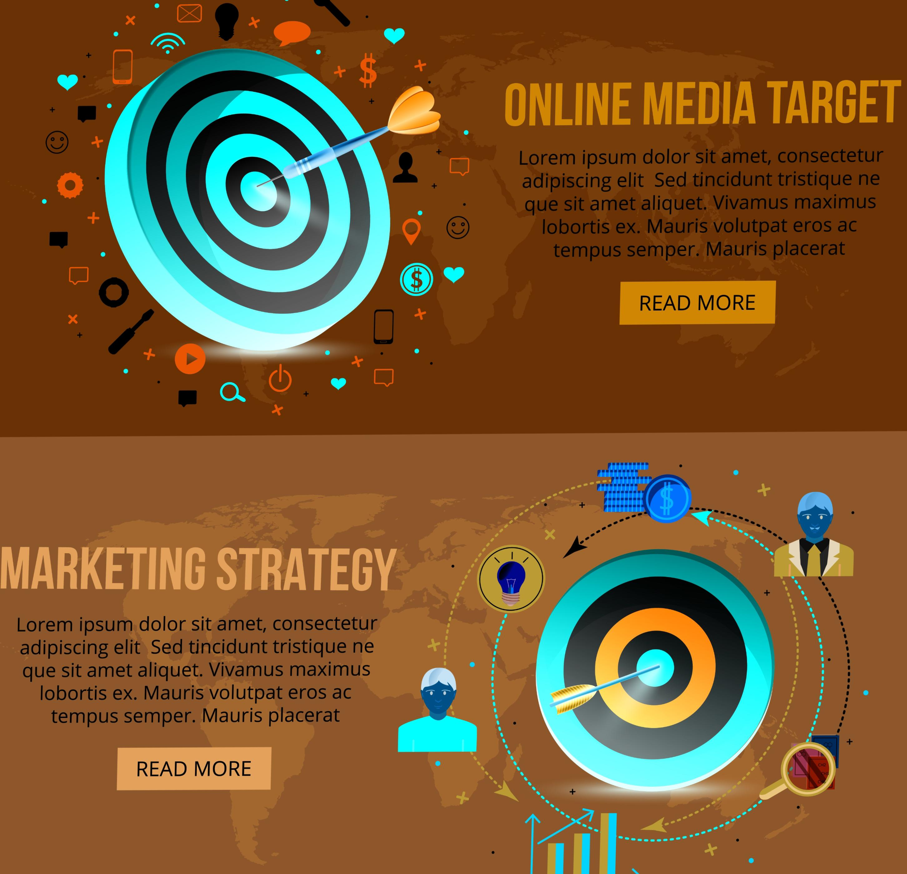
Result and screenshot
Visual proof of accomplishments. Showcase project outcomes. Demonstrate design and development skills. Highlight key features and functionalities. Provide context for user experience.

Slide 10

Conclusion
Summarize key accomplishments. Reiterate professional goals. Encourage contact and collaboration. Provide a clear call-to-action. Leave a lasting impression.

Slide 11

Github link
Showcases coding projects and repositories. Demonstrates version control expertise. Highlights collaboration and community involvement. Provides access to open-source contributions. Enhances credibility with potential employers.

Slide 12

Thank you

